Slide 1
THE SEDIMENTS OF GLYPHADA CAVE AT DIROS LACONIA AND THEIR CONTRIBUTION TO THE STUDY OF THE PALEOENVIRONMENT
Dr Vassilis Giannopoulos Ioannis Giannopoulos

Slide 2
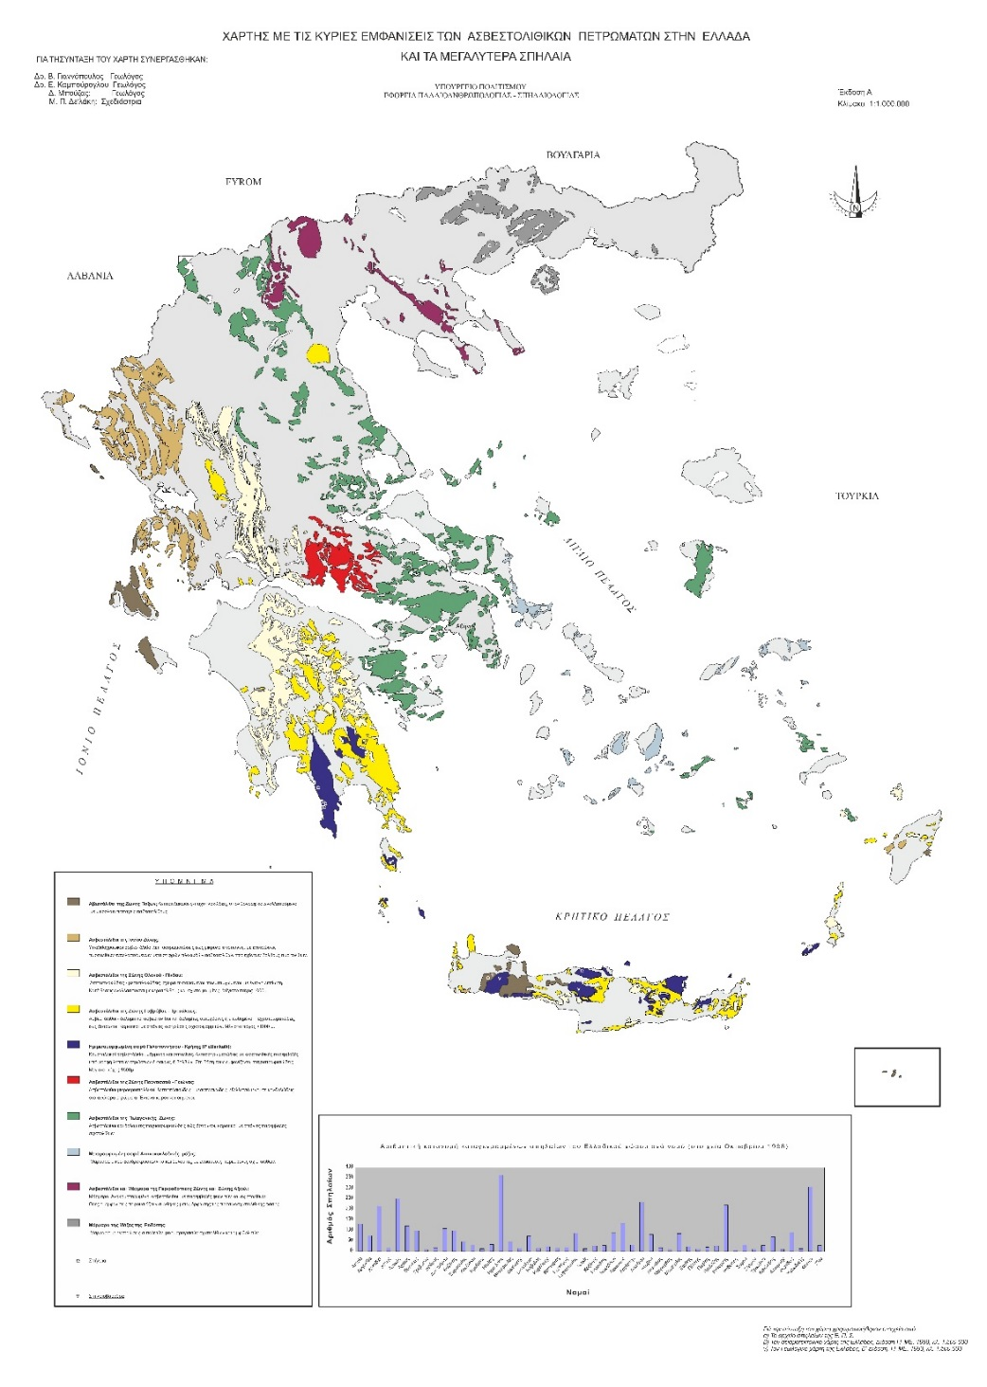
LIMESTONE DEVELOPING IN GREECE
Οι κυριώτερες εμφανίσεις ασβεστολίθων στην Ελλάδα

Slide 3
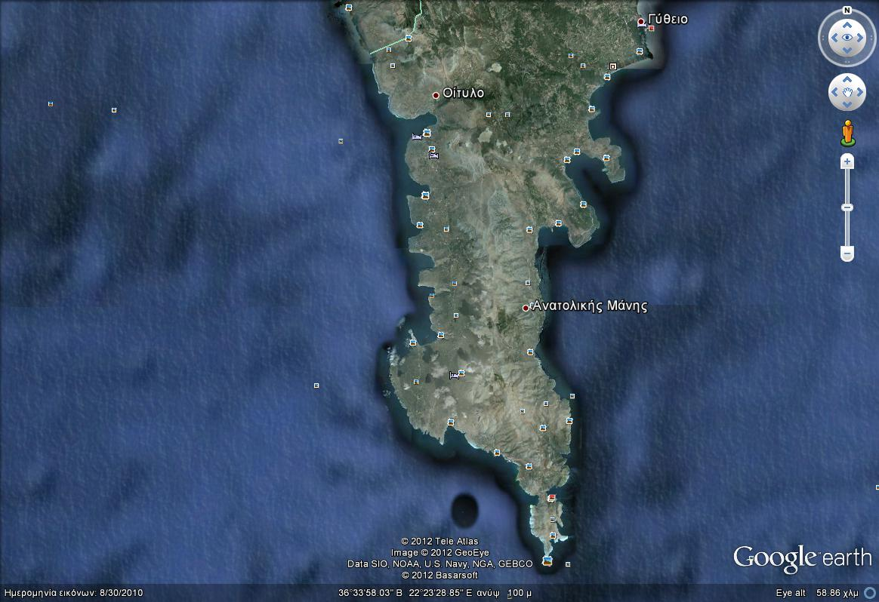
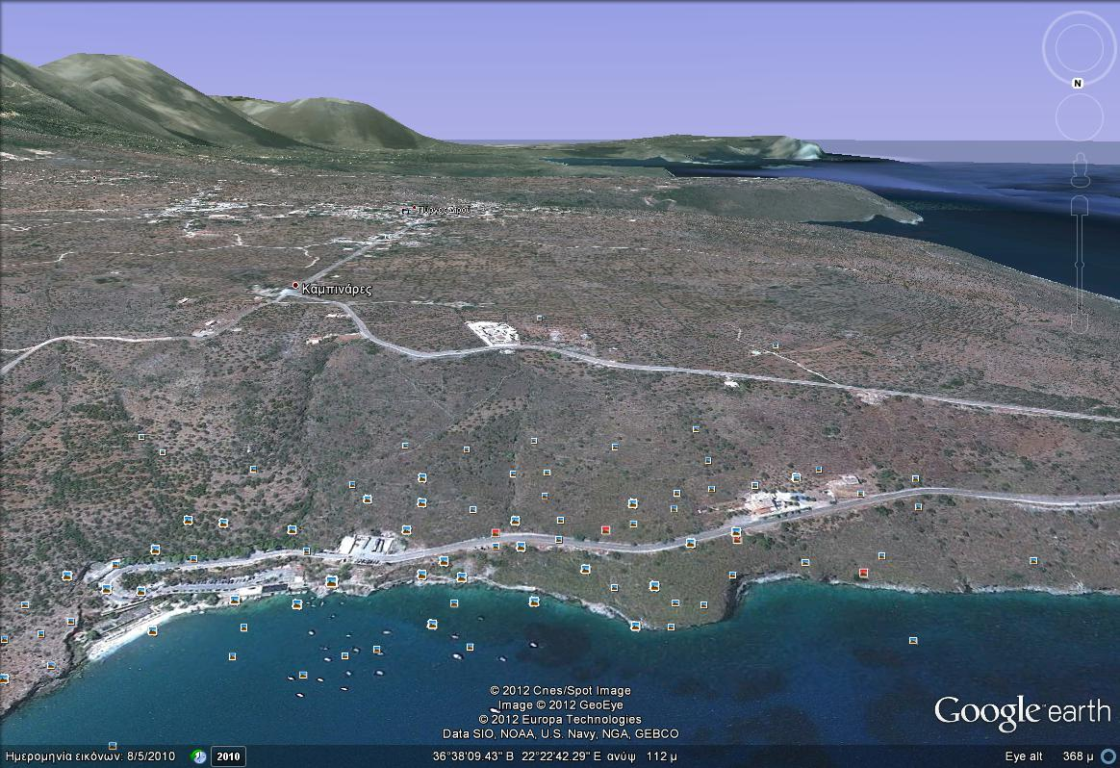

Slide 4
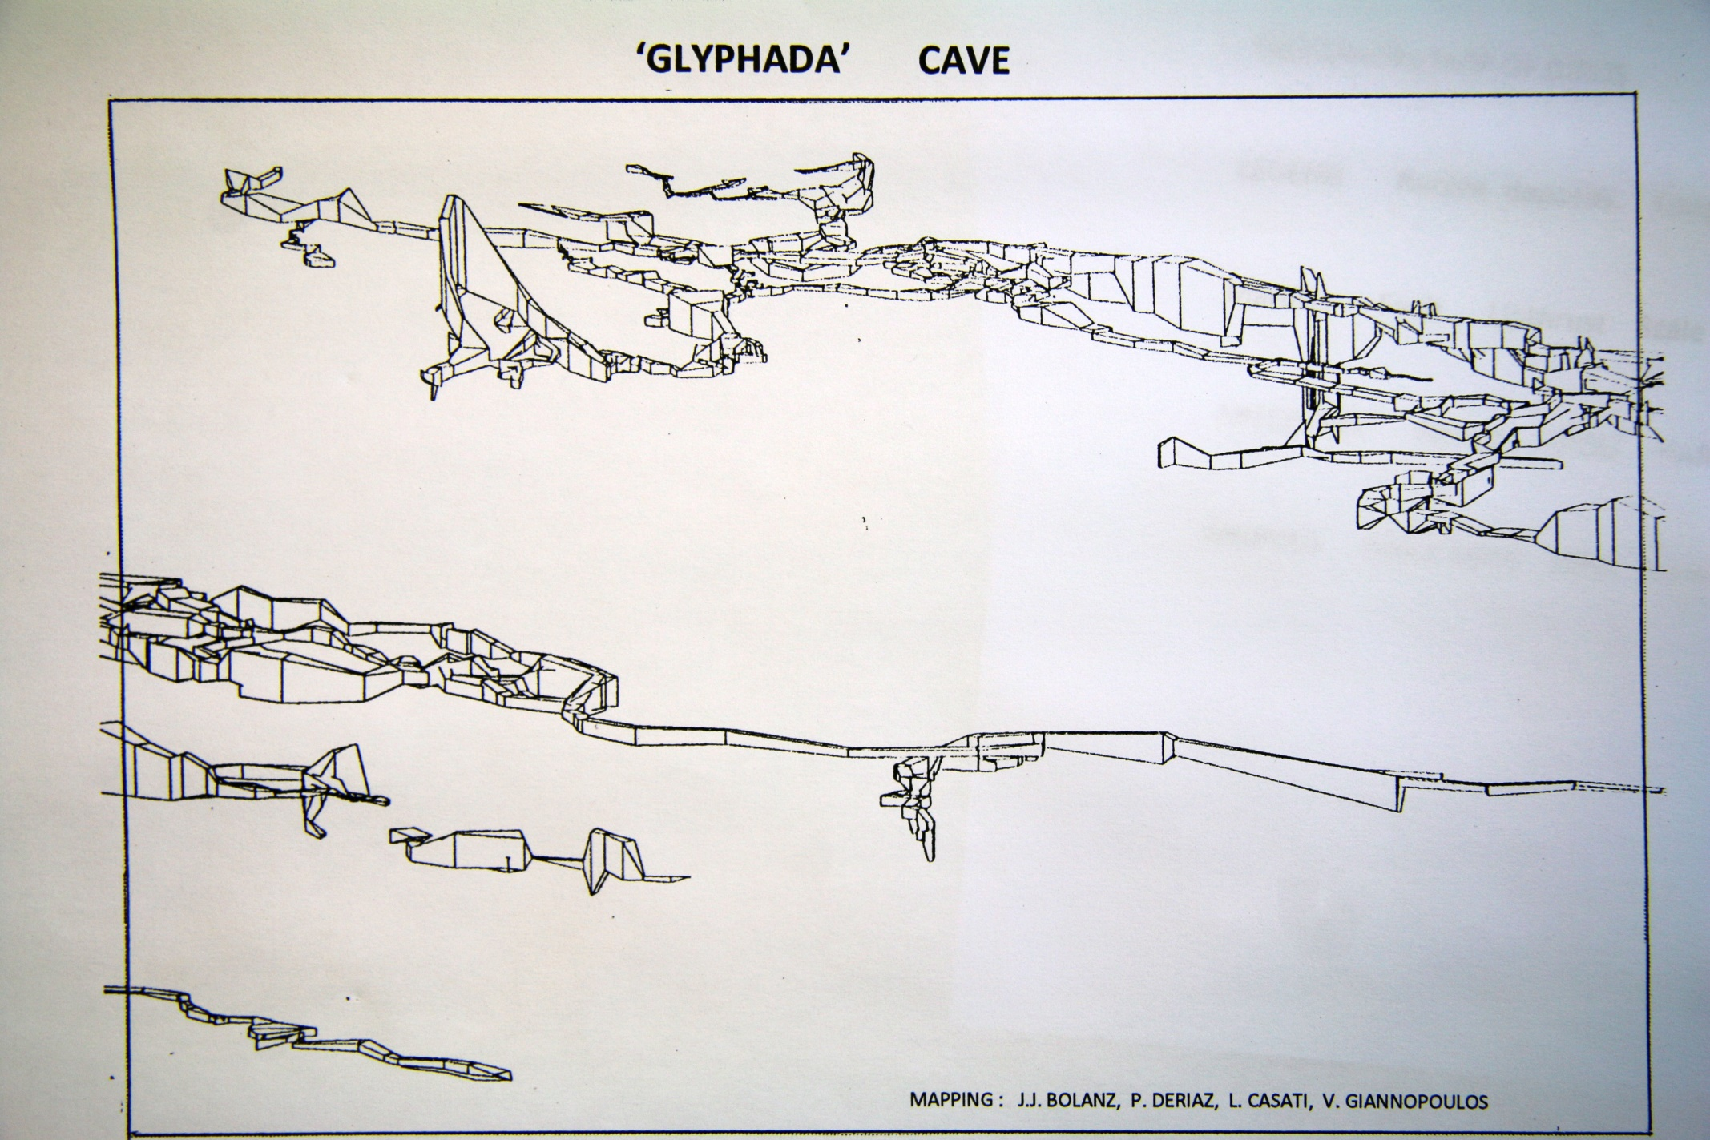

Slide 5
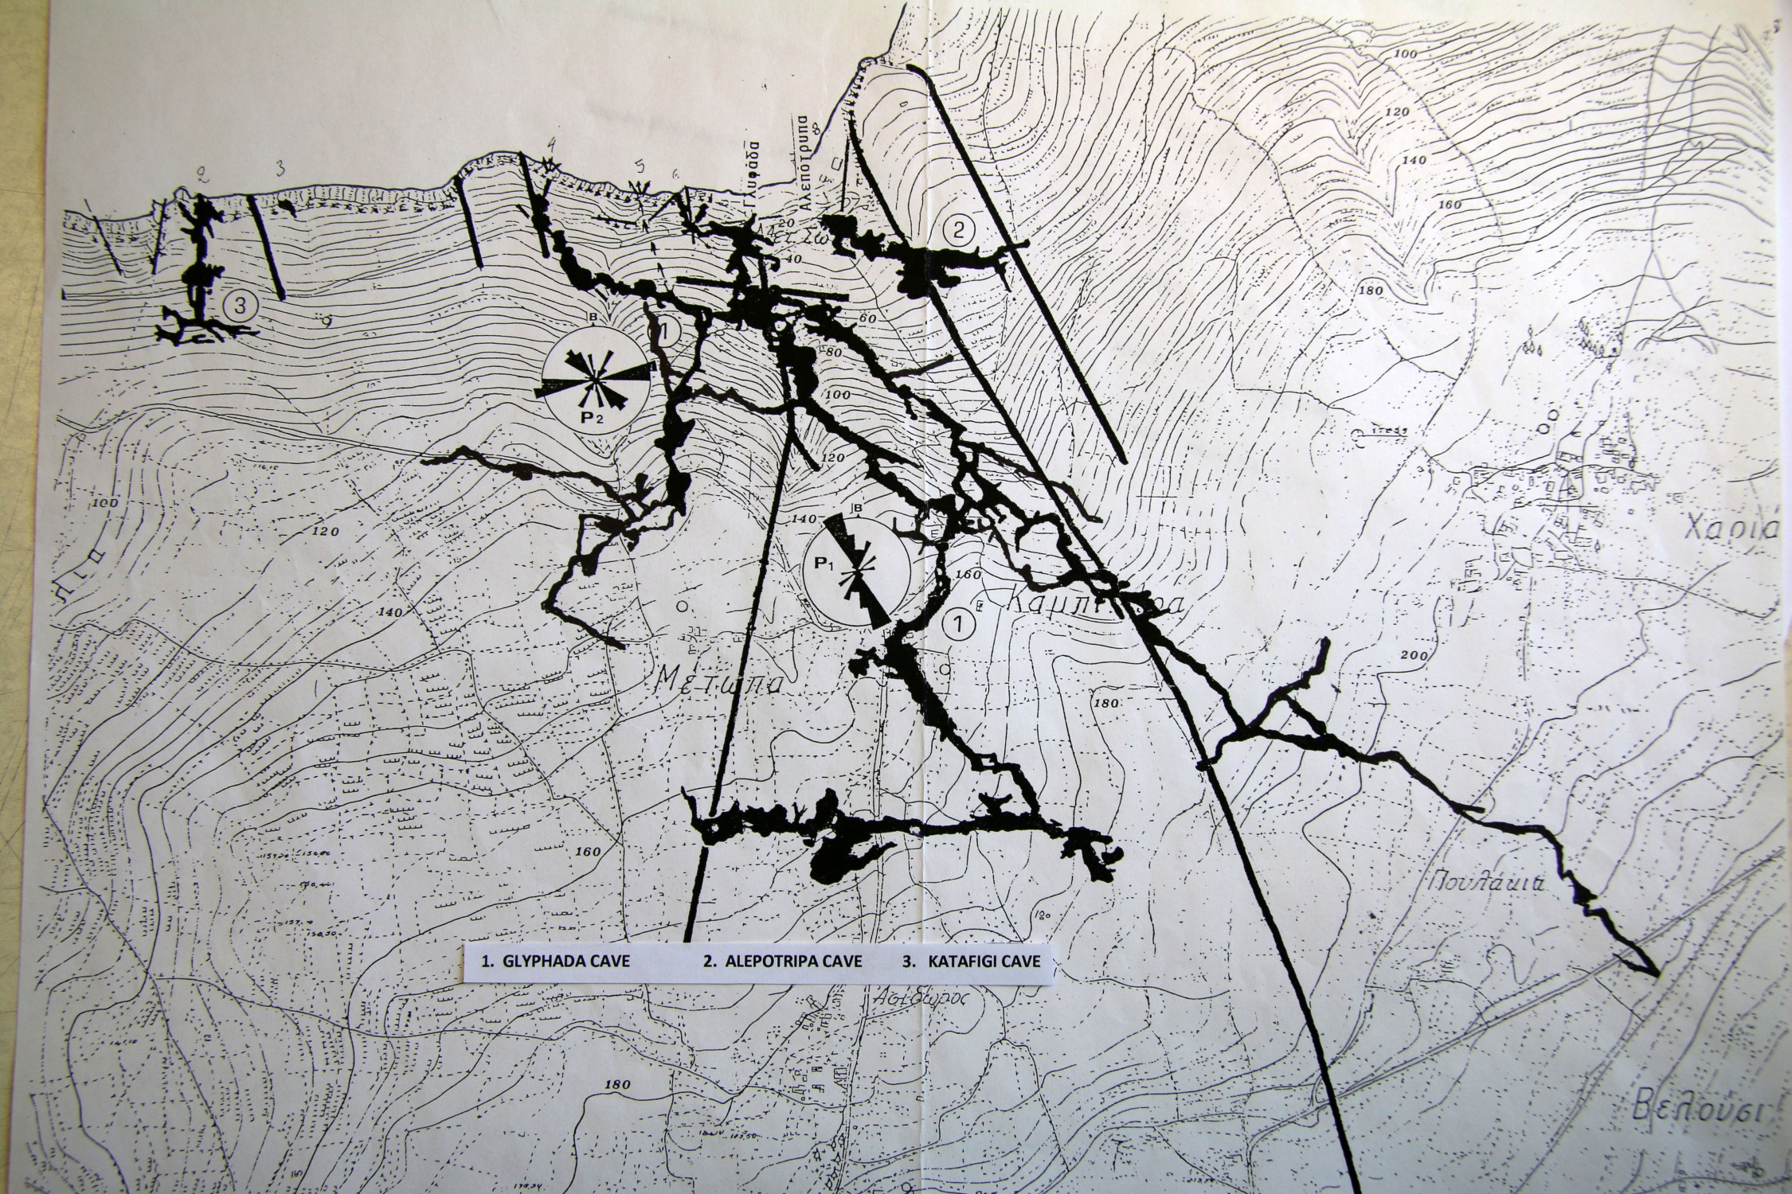

Slide 8
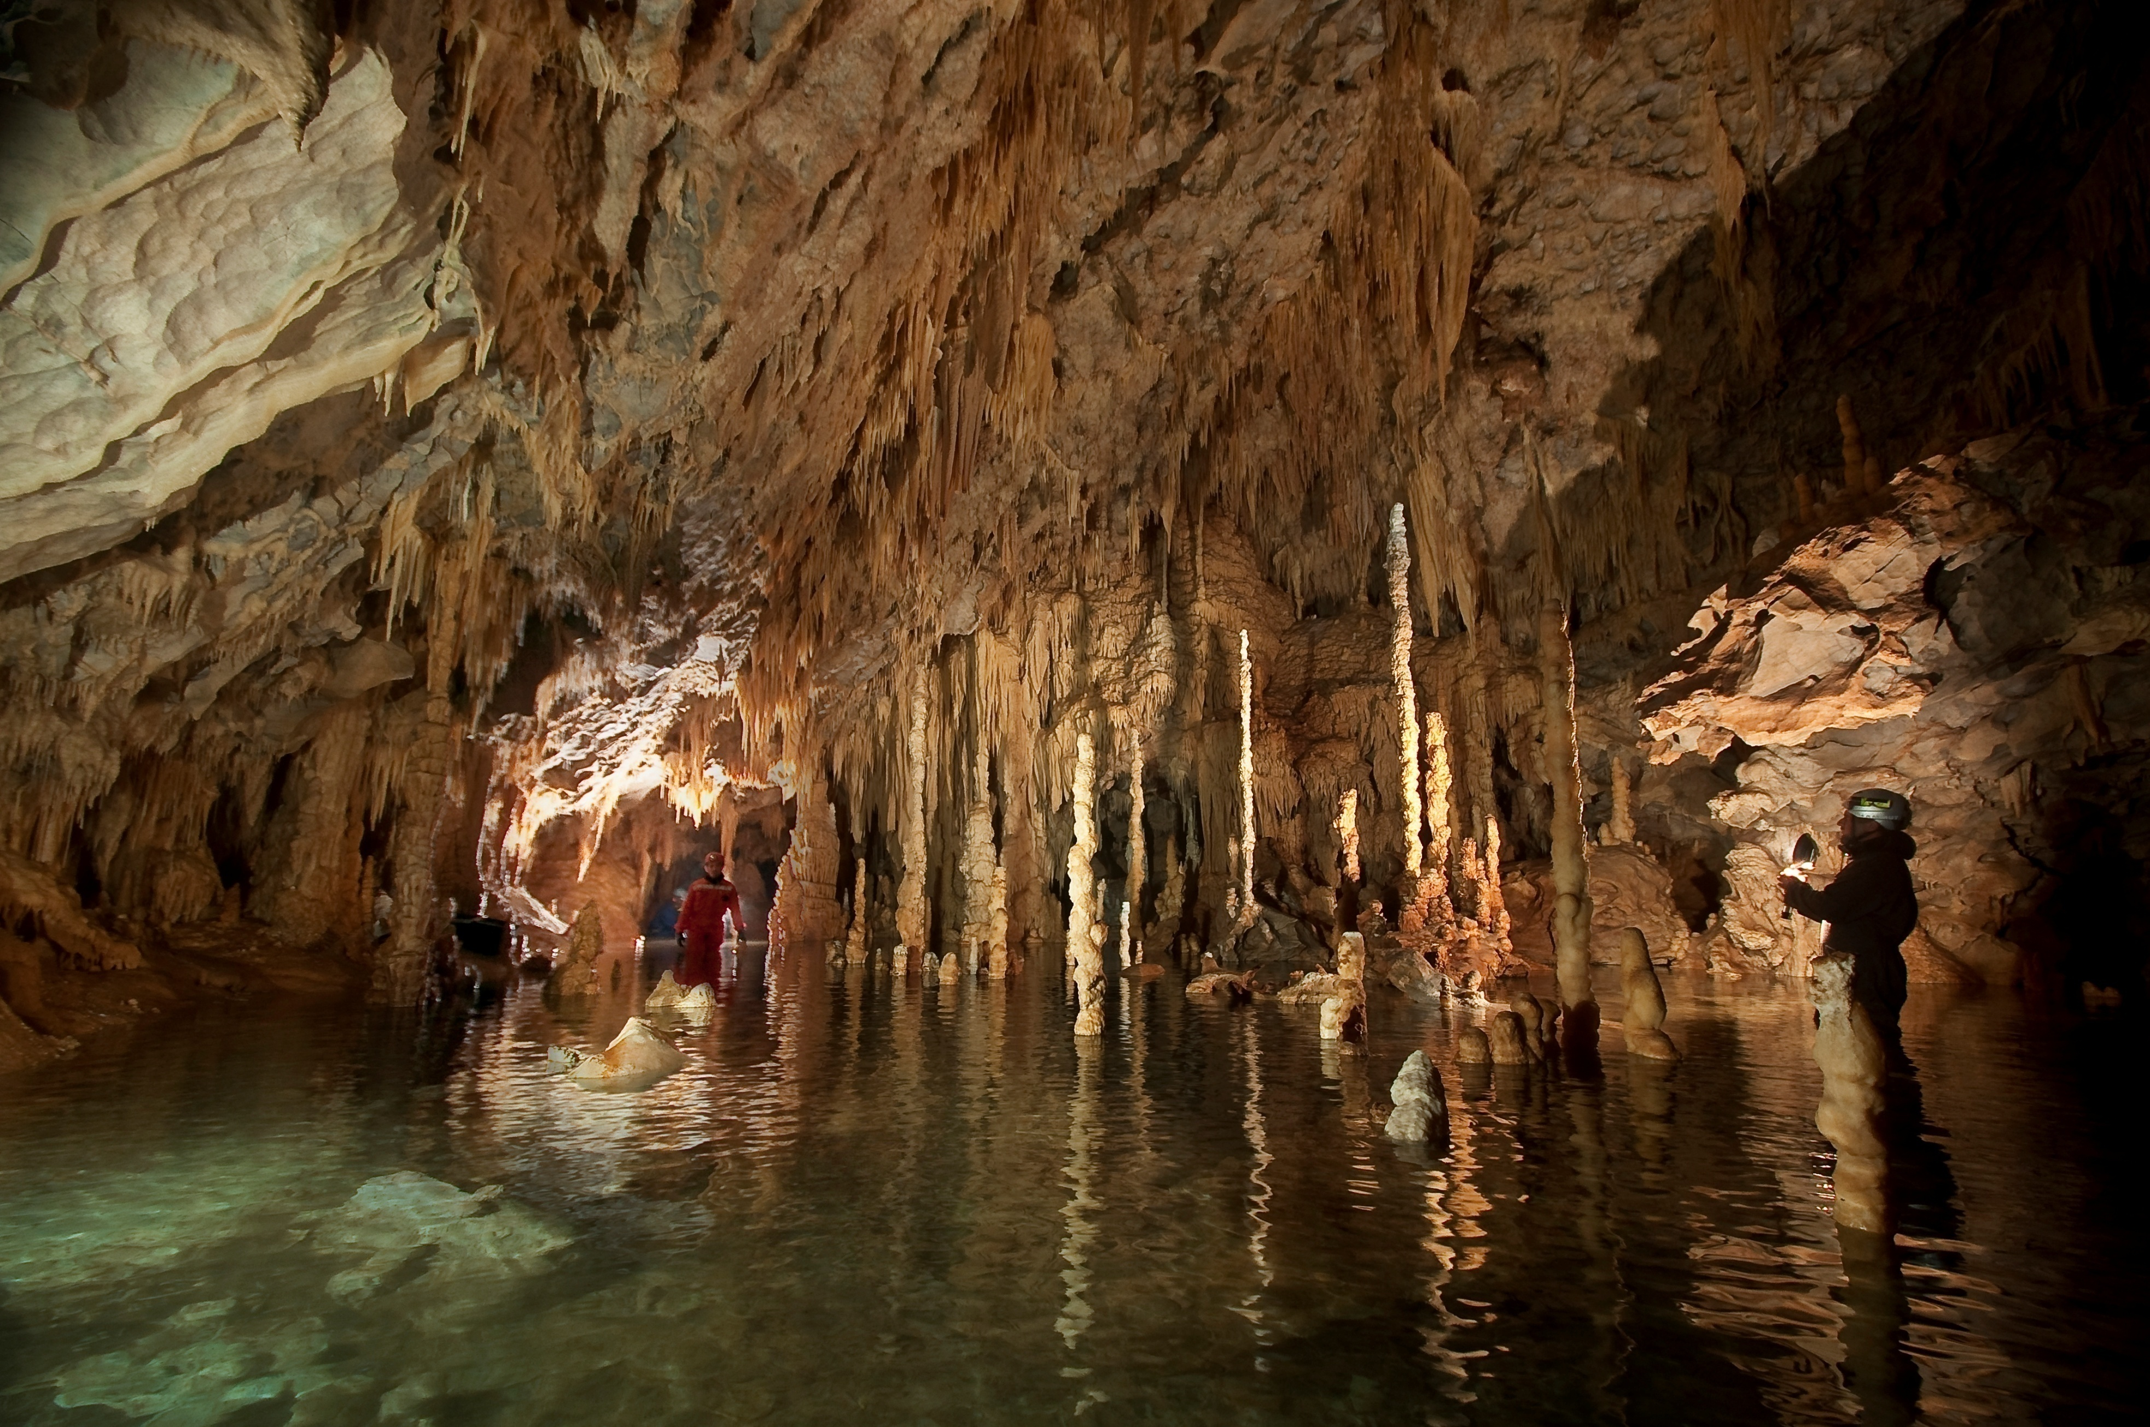

Slide 9
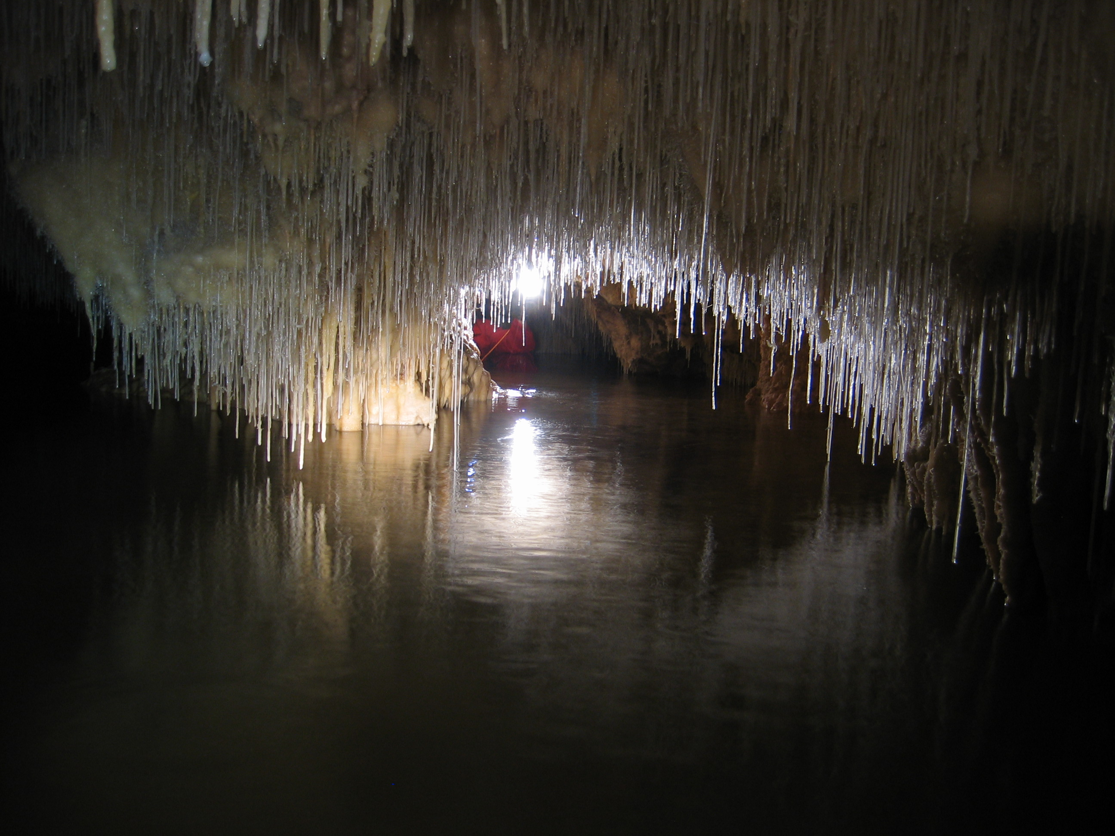

Slide 11
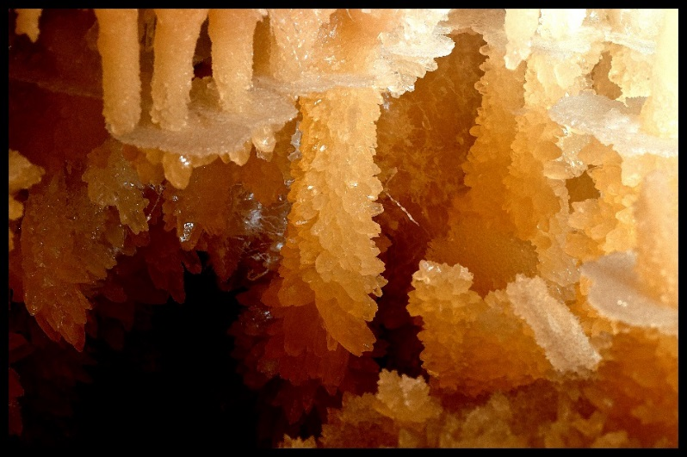
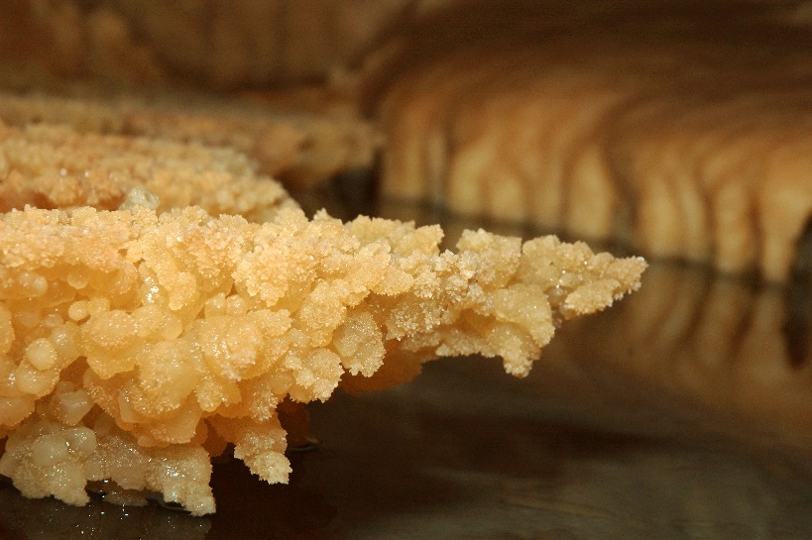

Slide 12
TEMPERATURE

Slide 13
HUMIDITY

Slide 14
CARBON DIOXIDE

Slide 16
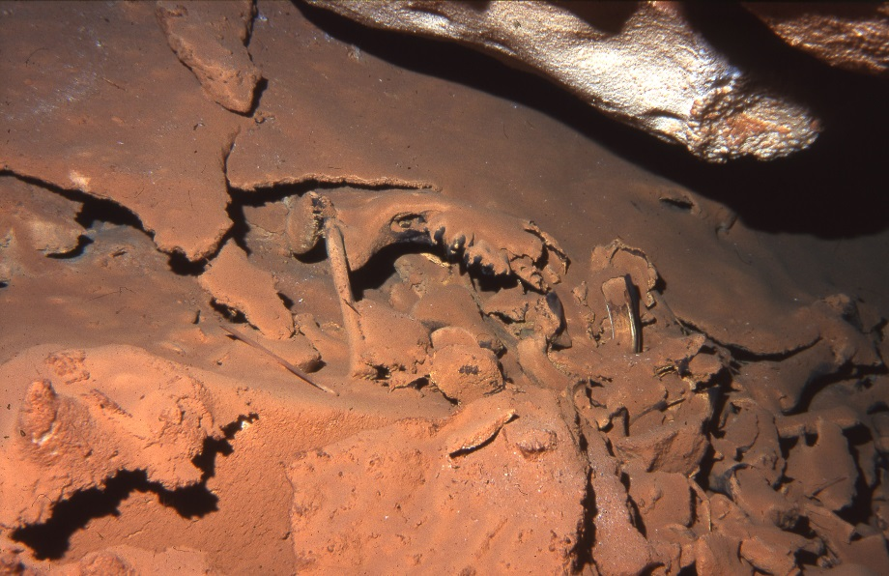

Slide 18
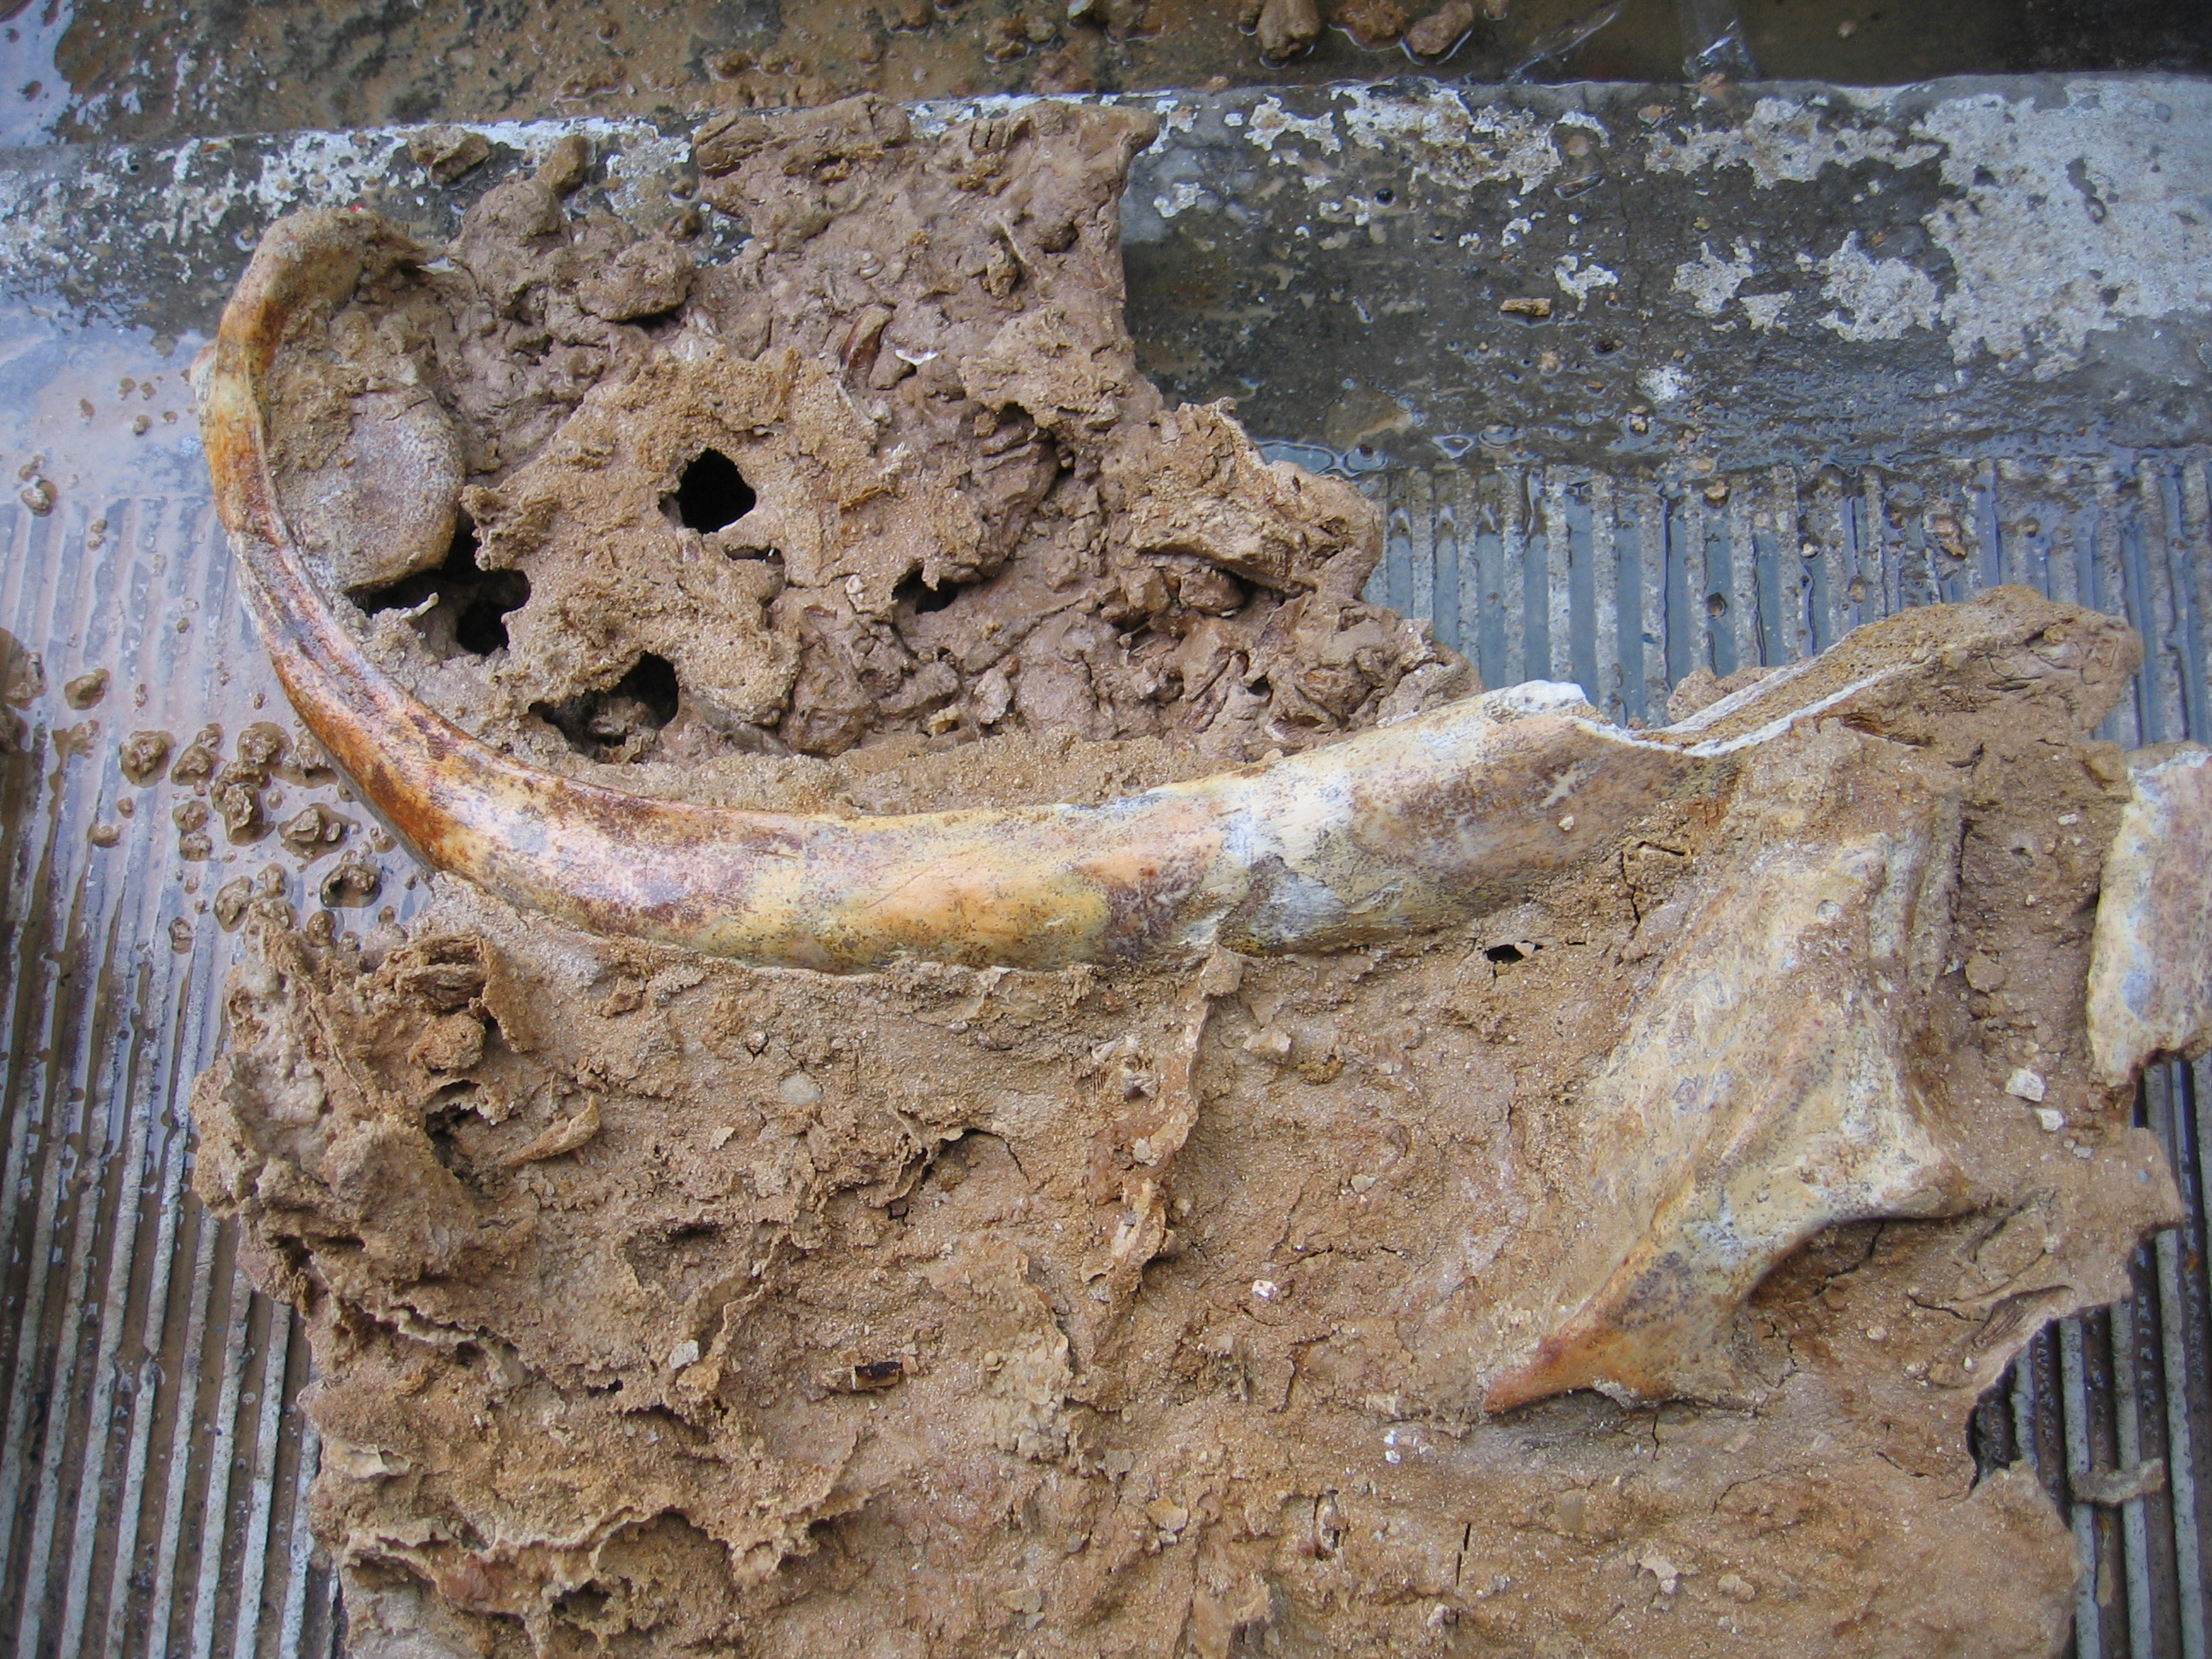

Slide 19
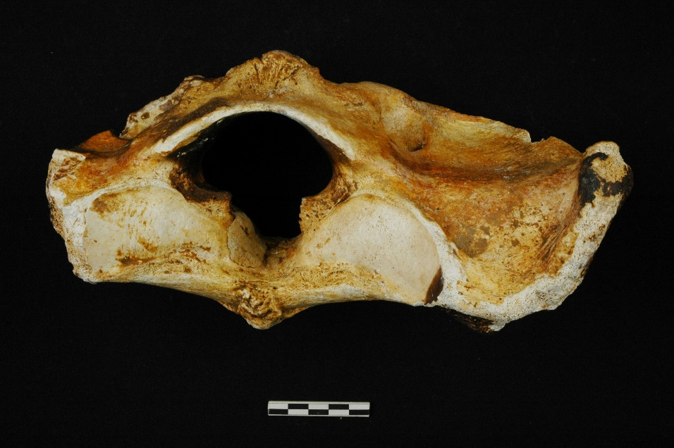
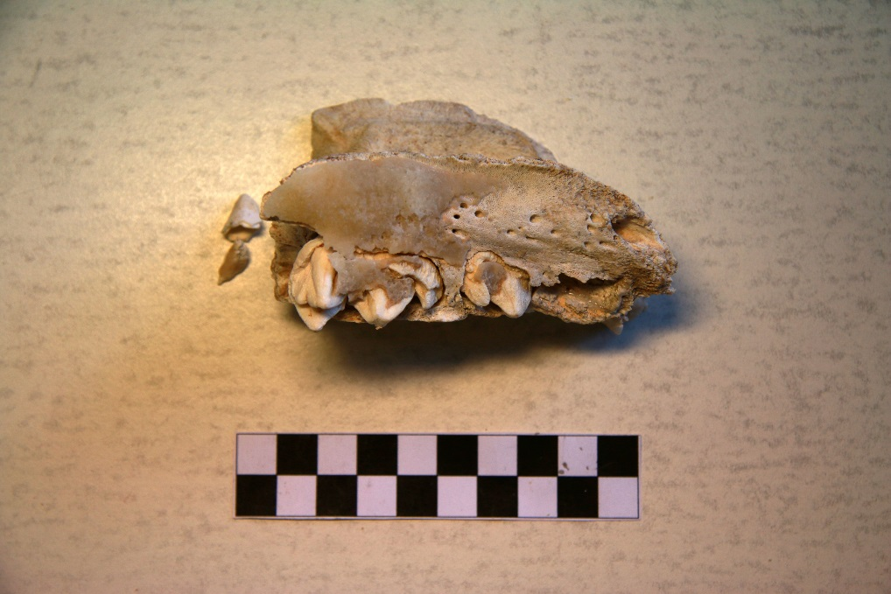
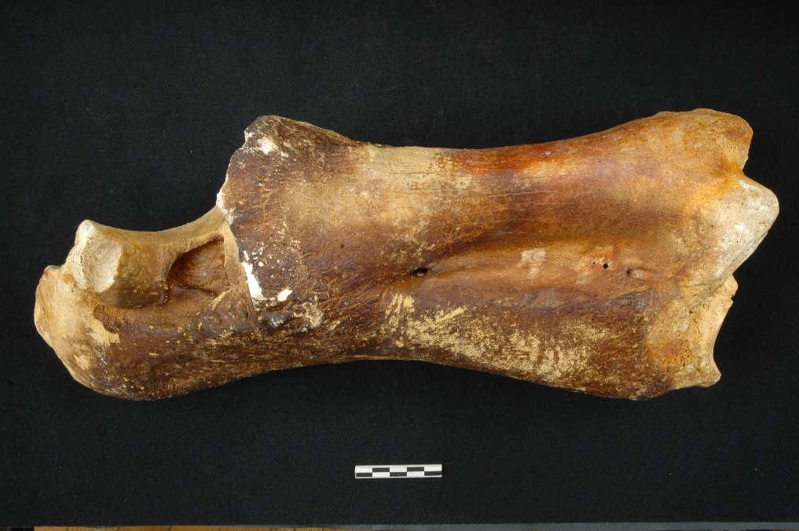

Slide 20
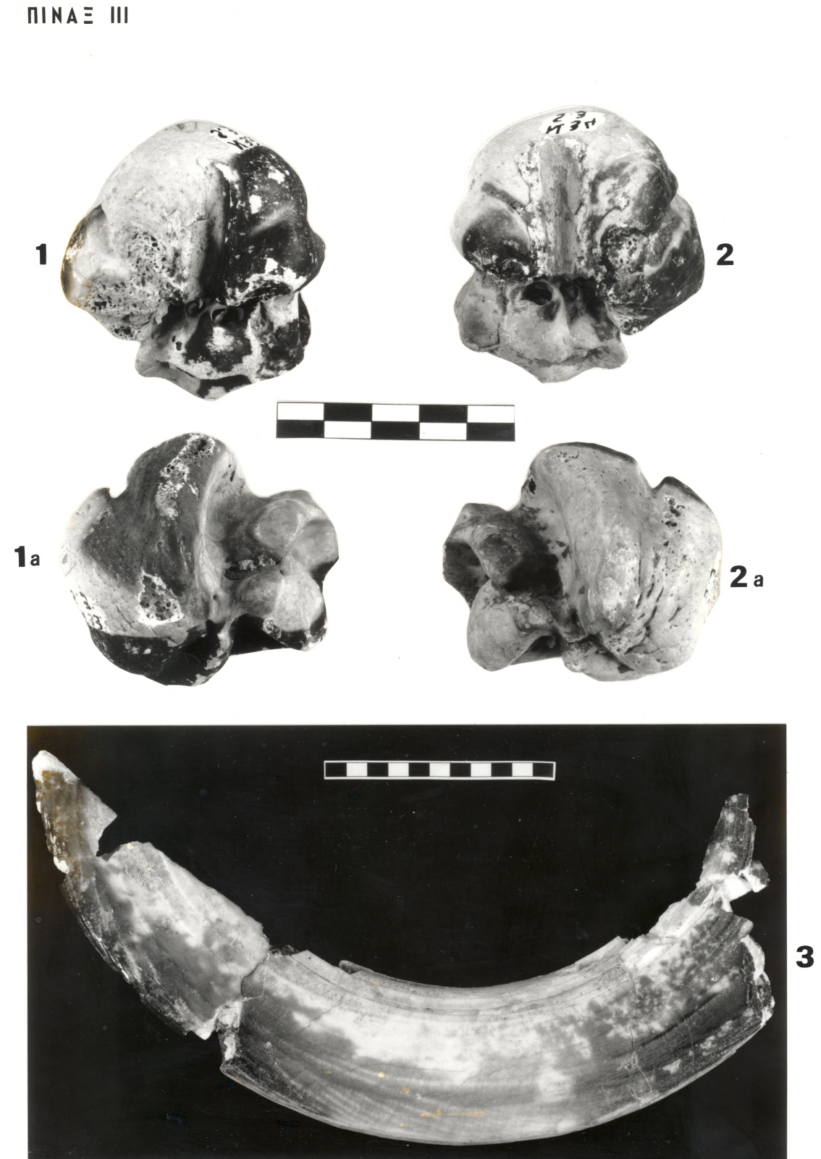
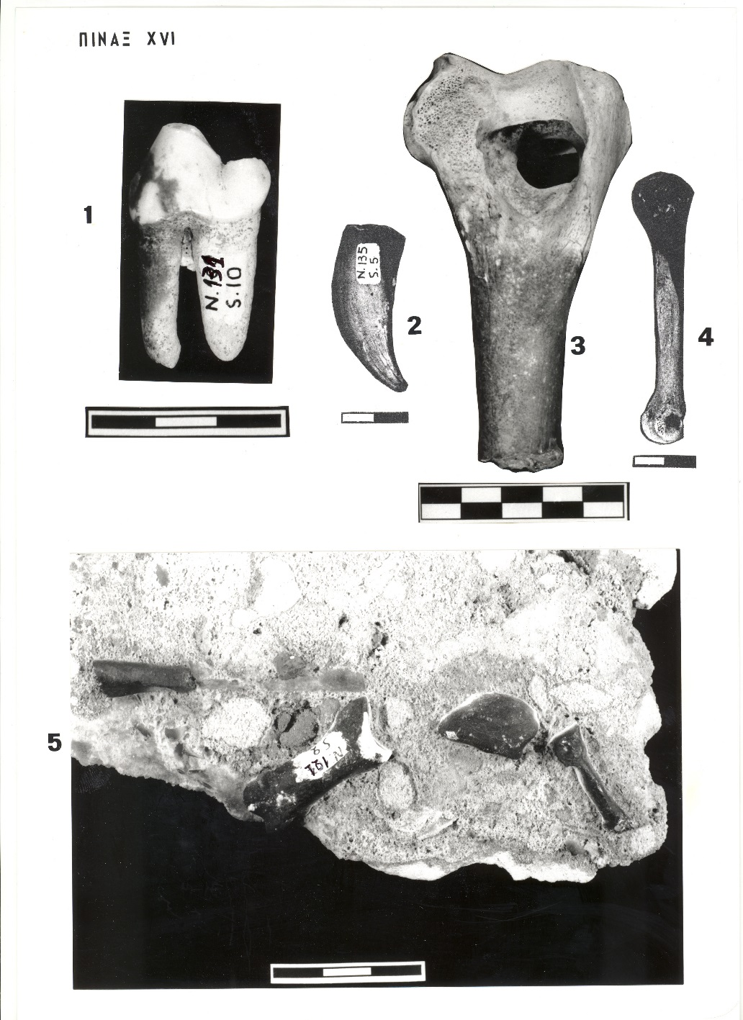

Slide 21
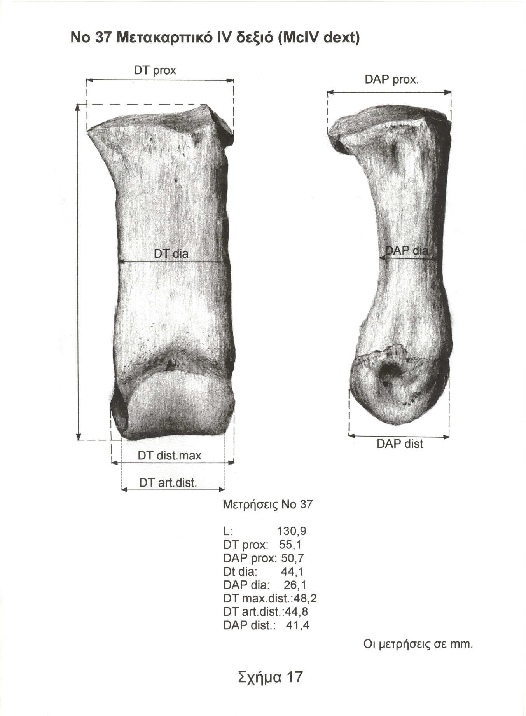
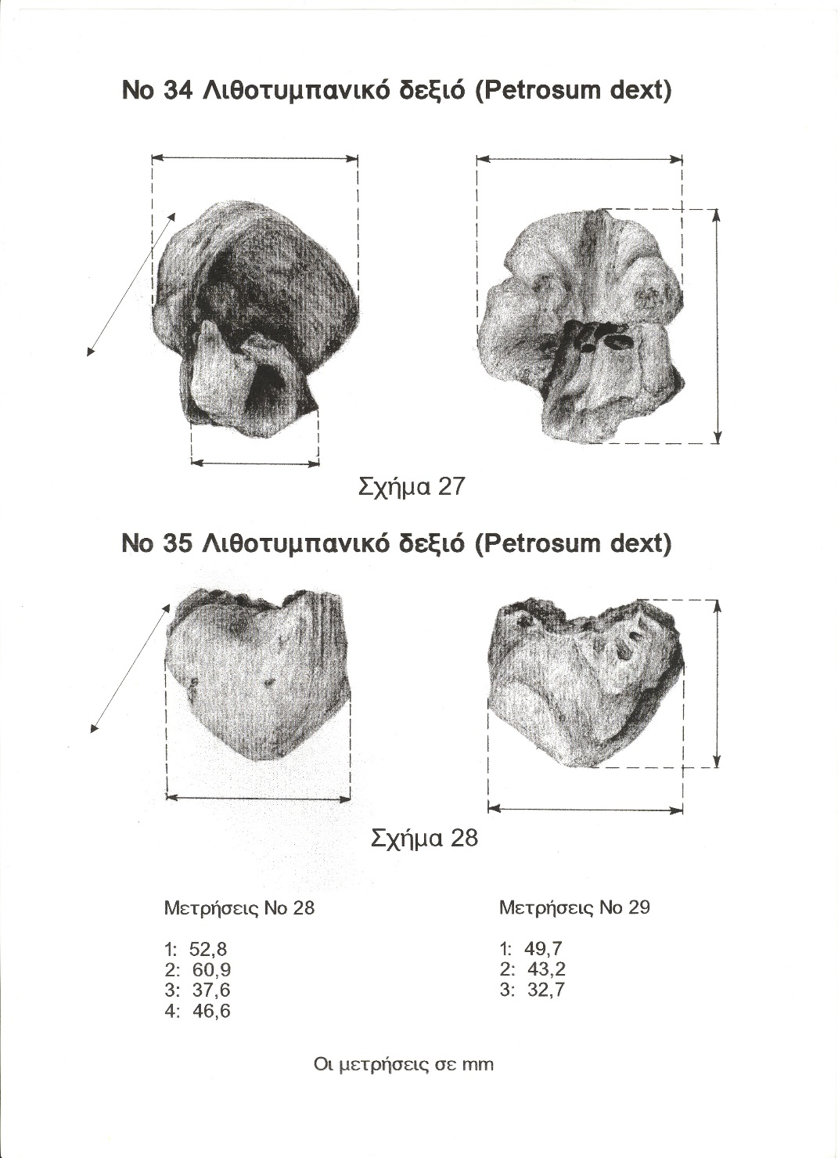

Slide 22
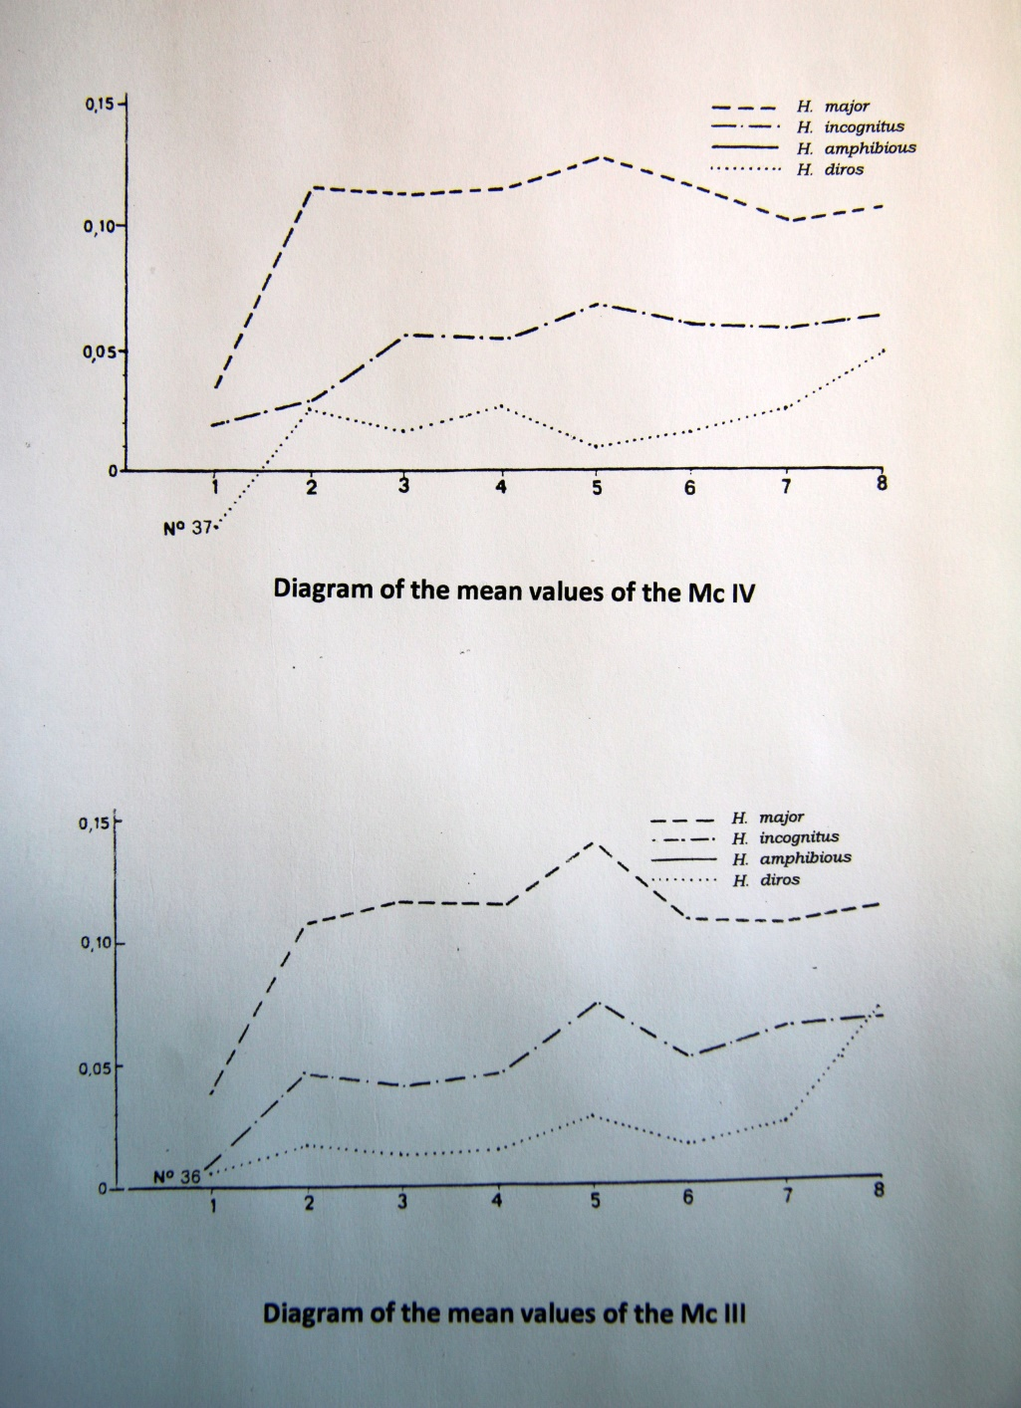
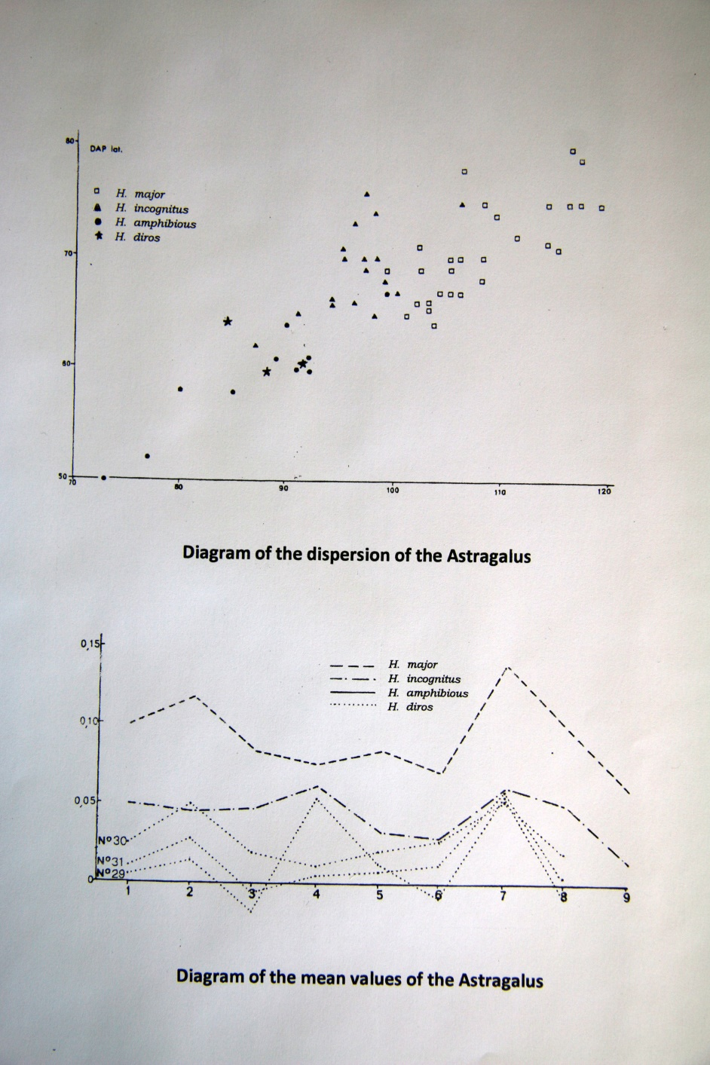

Slide 23
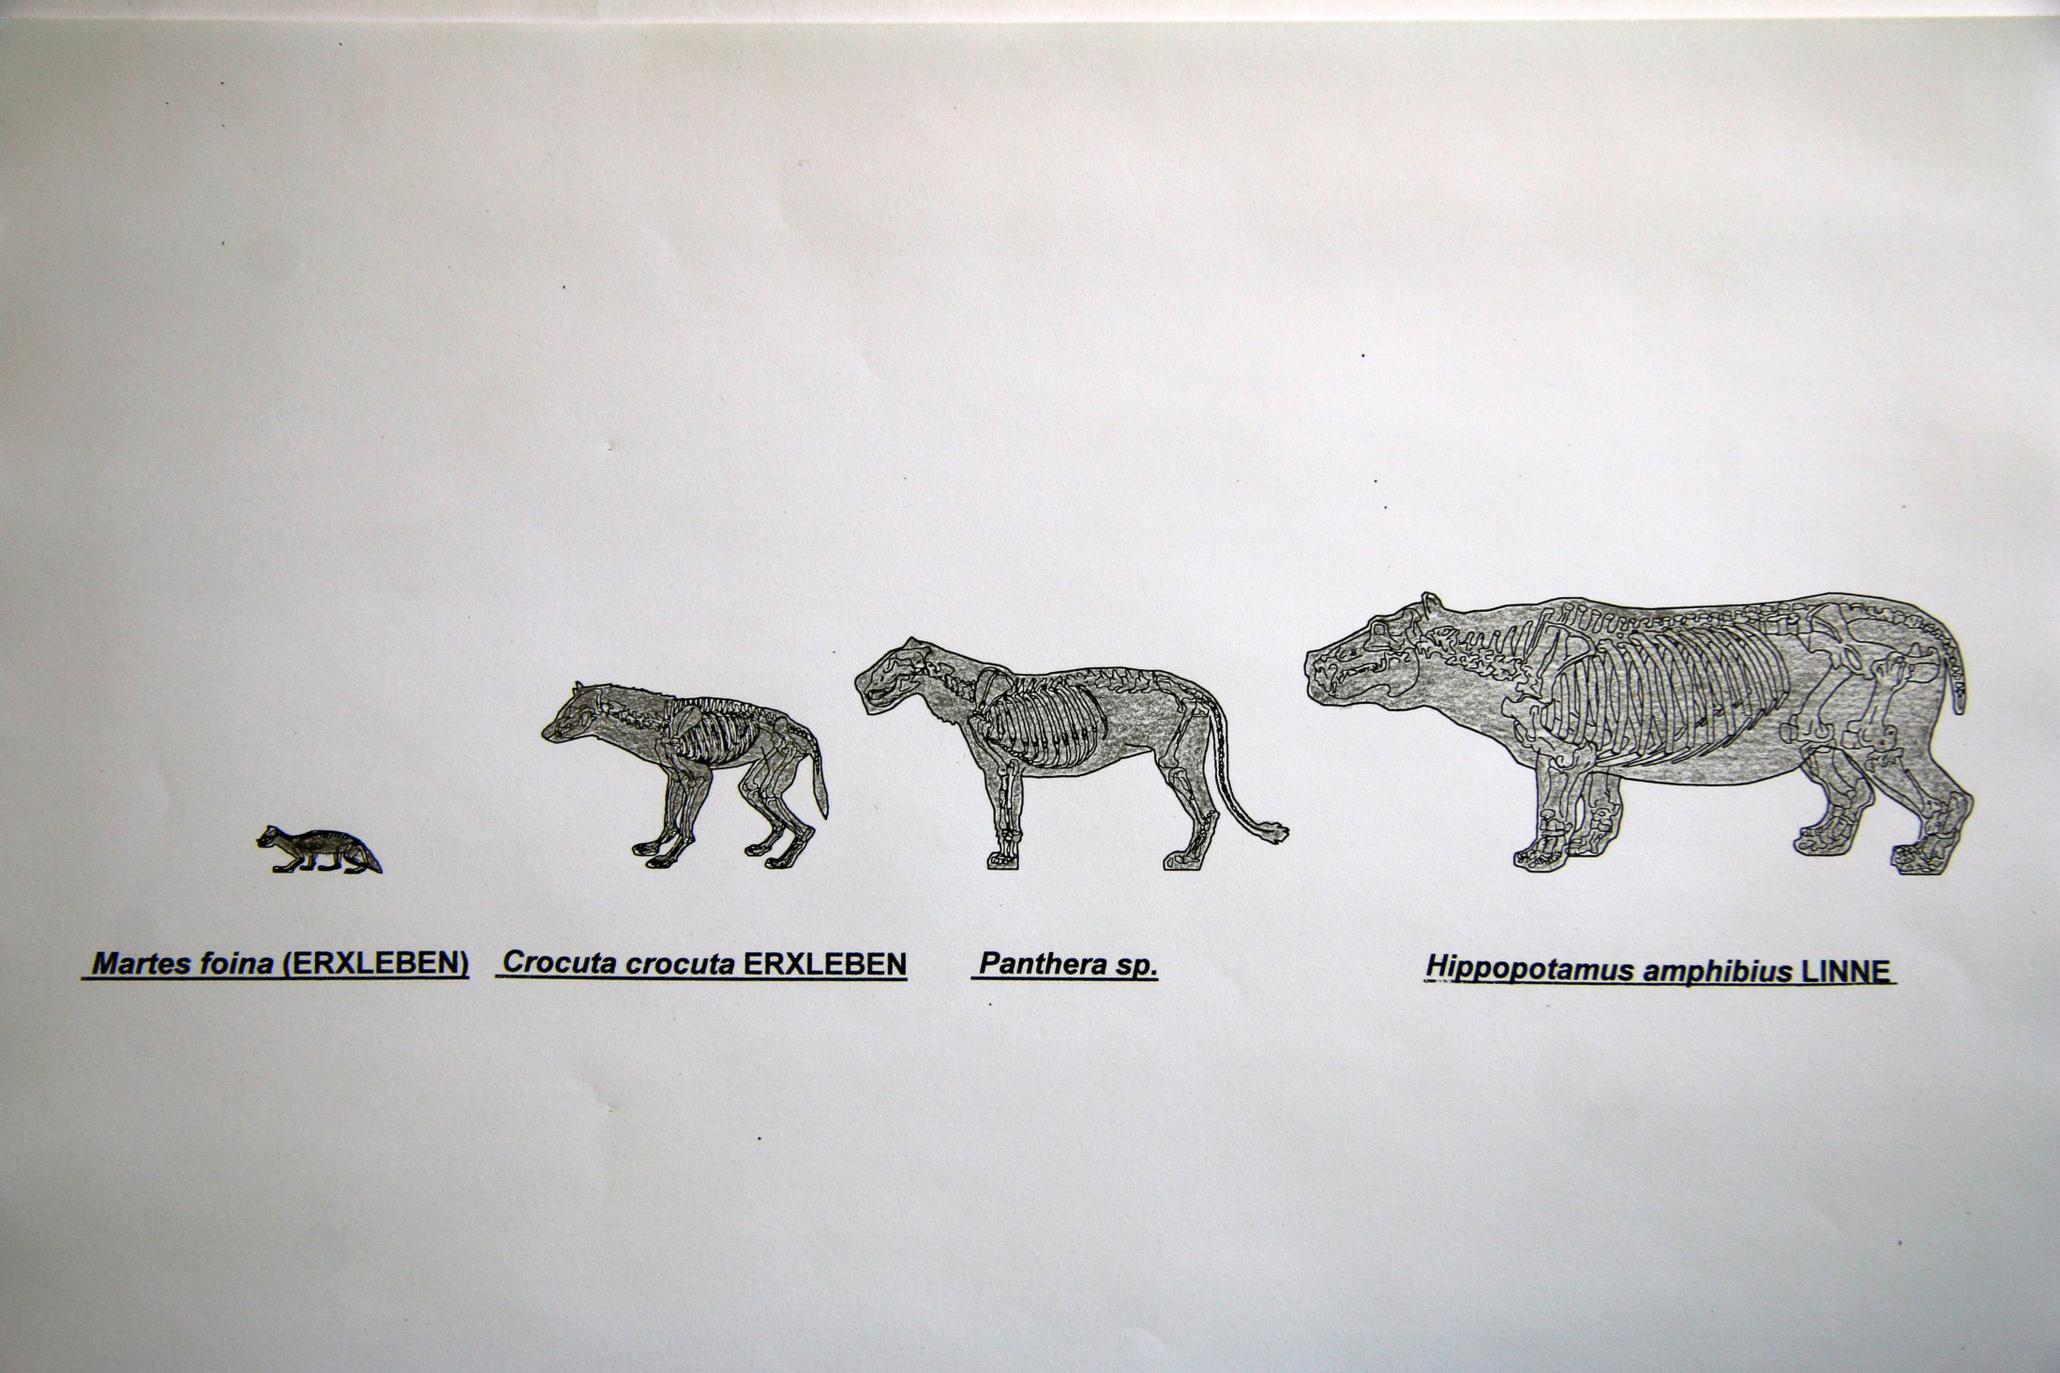

Slide 25
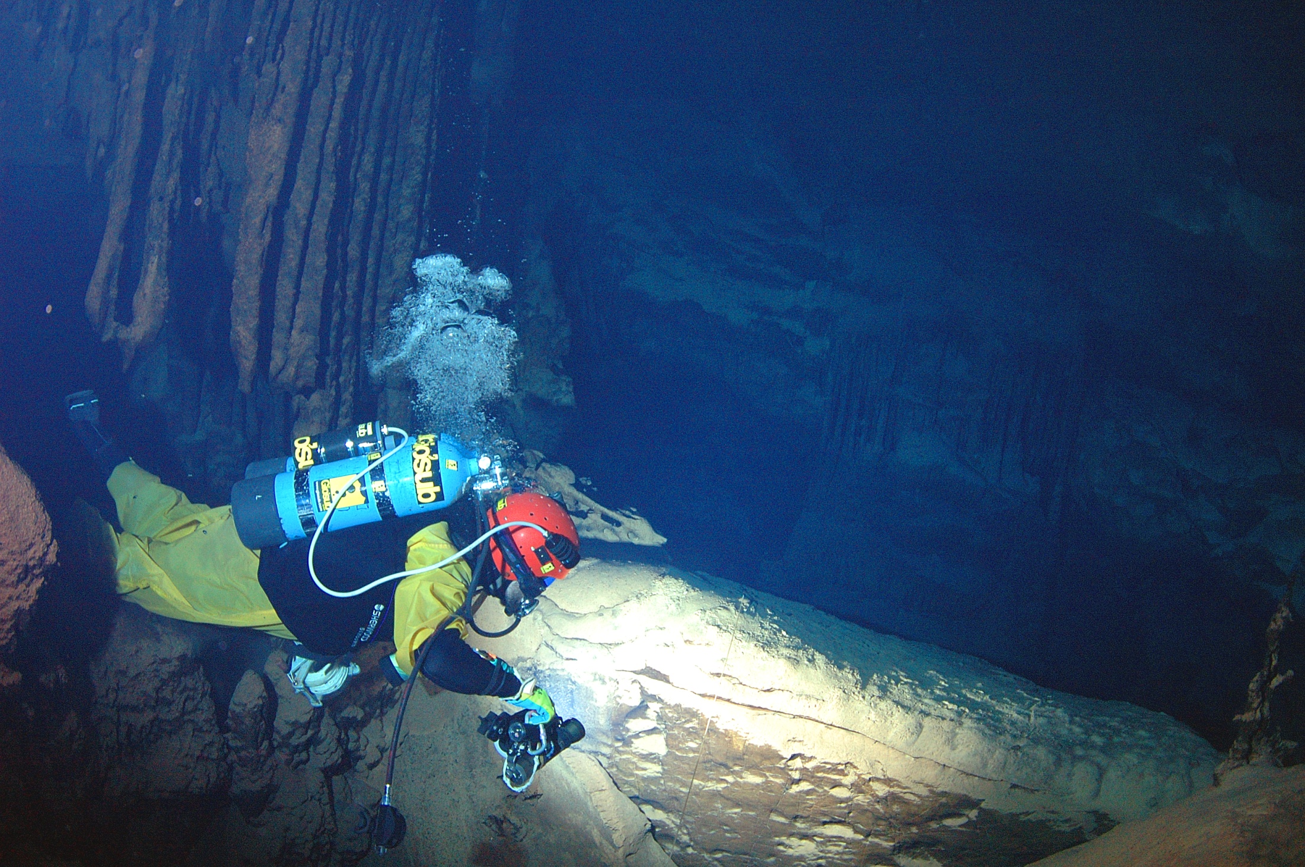

Slide 27
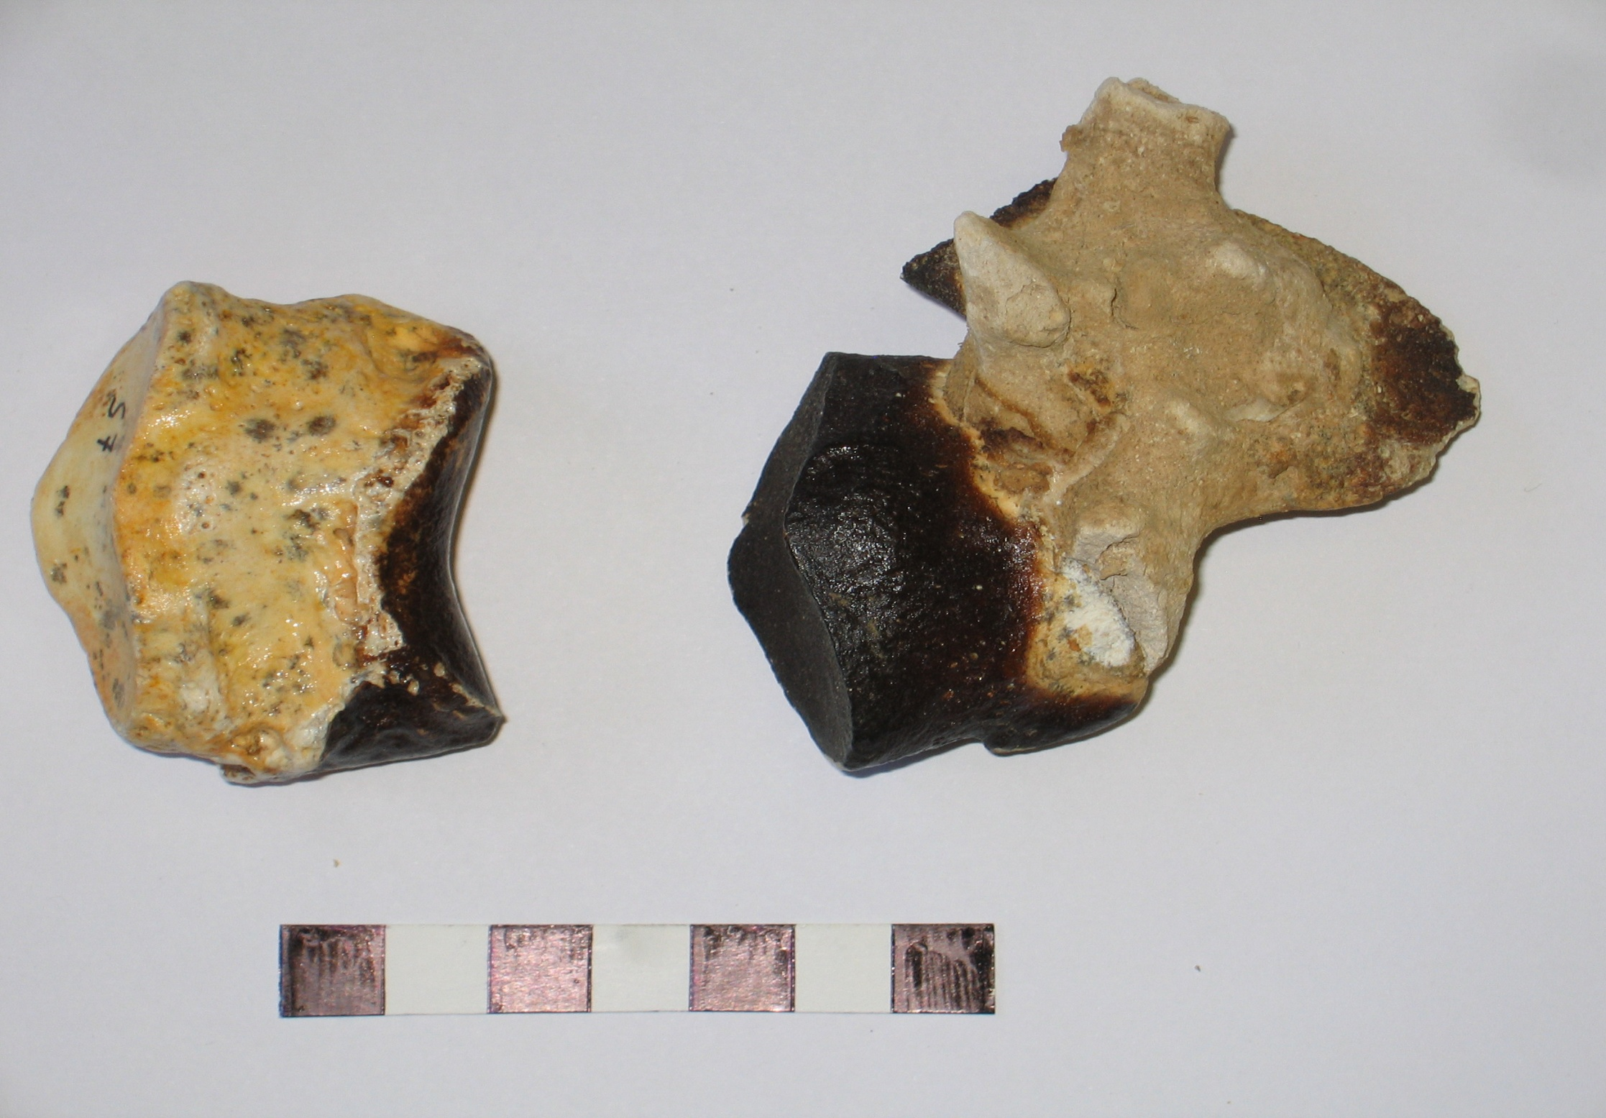

Slide 28
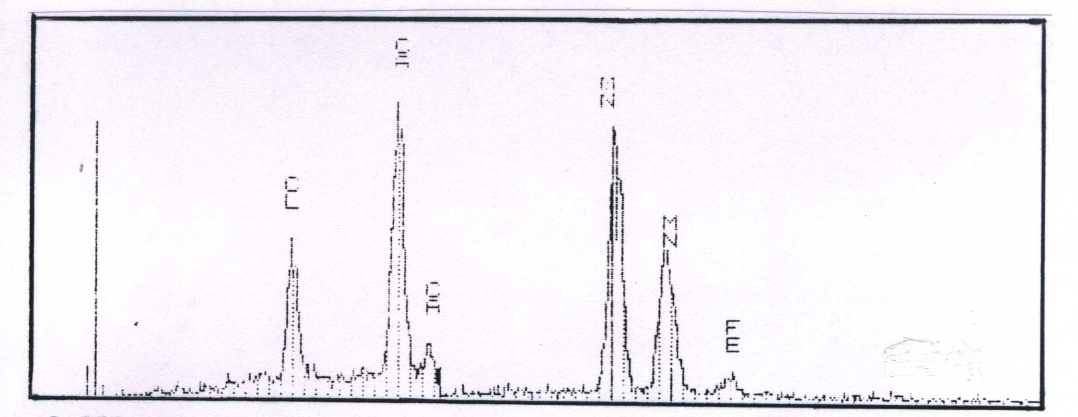
Manganese Oxide with little content of Ferrum
X-rays diagram

Slide 29
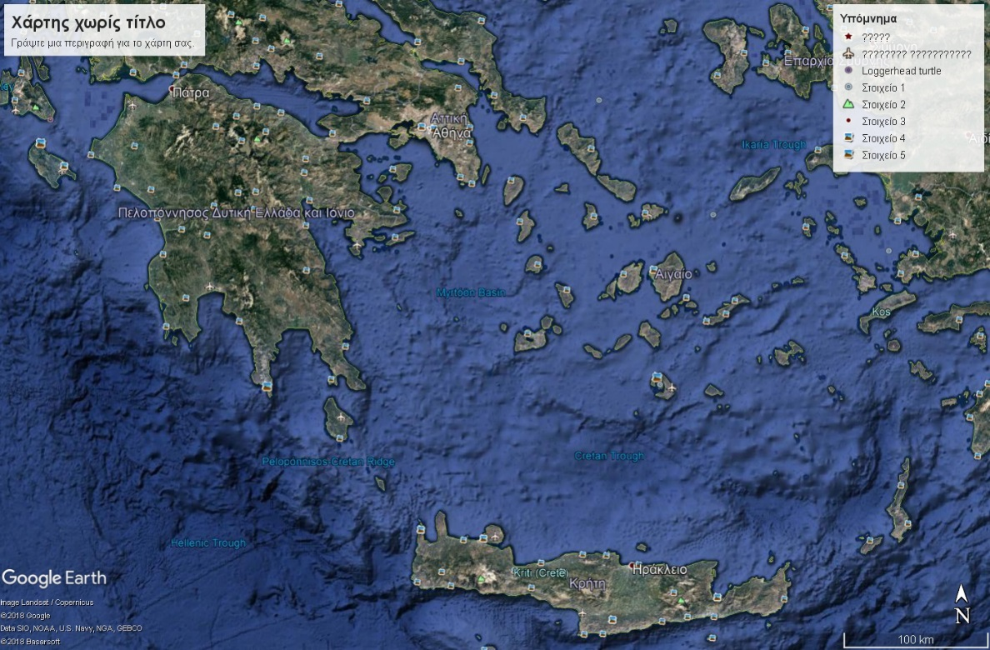
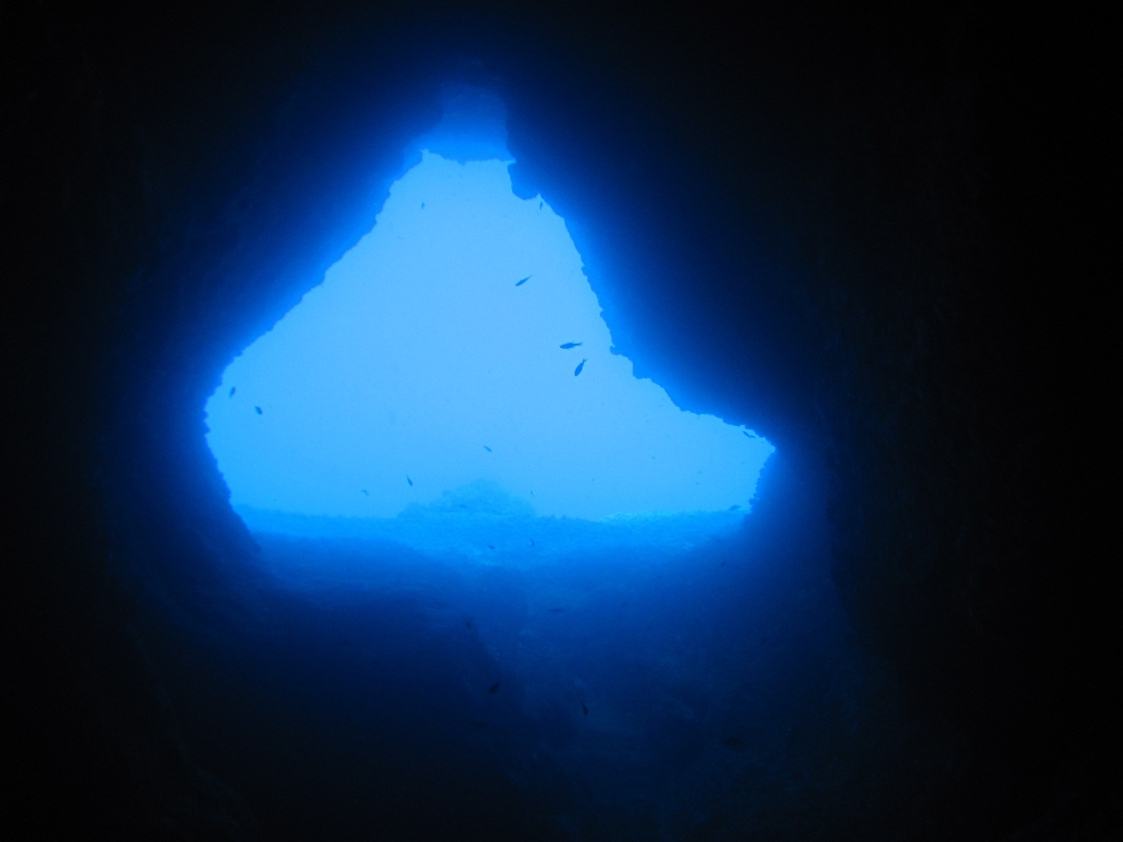

Slide 31
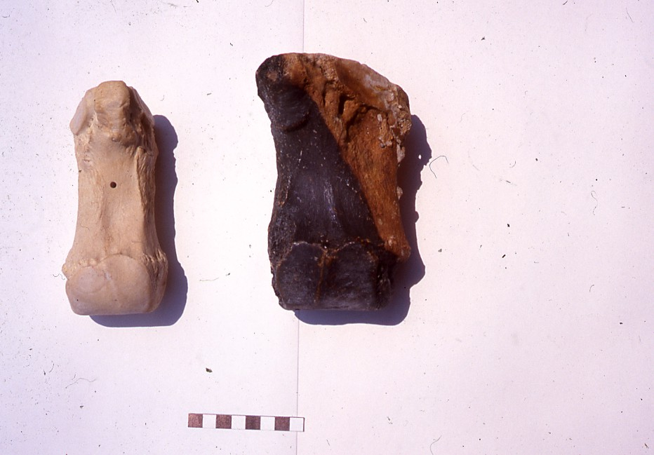

Slide 32
The ongoing study aims to the following
1. Research on the aetiology of the presence of the paleontological material inside Glyphada cave.
2. Research on the aetiology of the presence of manganese layer on all surfaces been located underwater.
3. Precise dating of the deposition of manganese layer and evaluation of the expansion of the phenomenon.

